Slide 1
Networks and Social Network Analysis
CUNY LaGuardia Community College

Slide 2
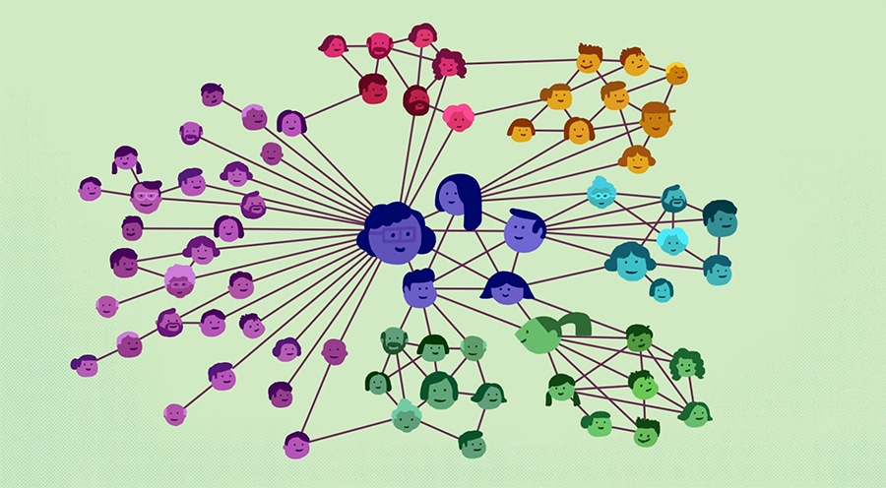
Networks

Slide 3
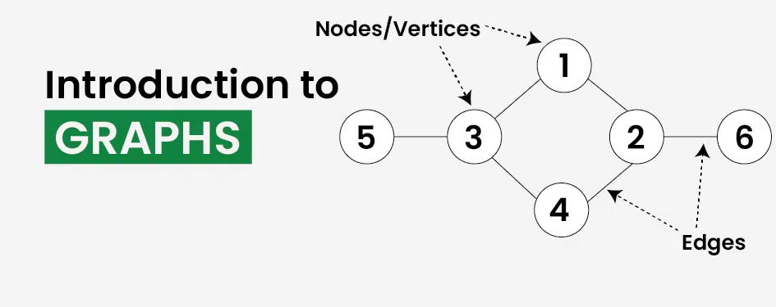
What are Networks?

Slide 4
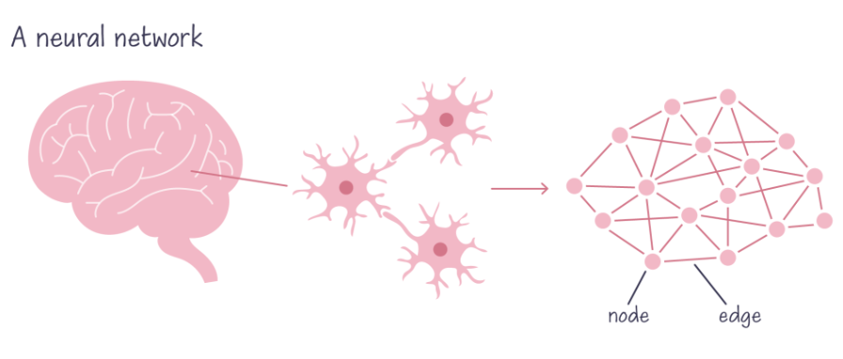
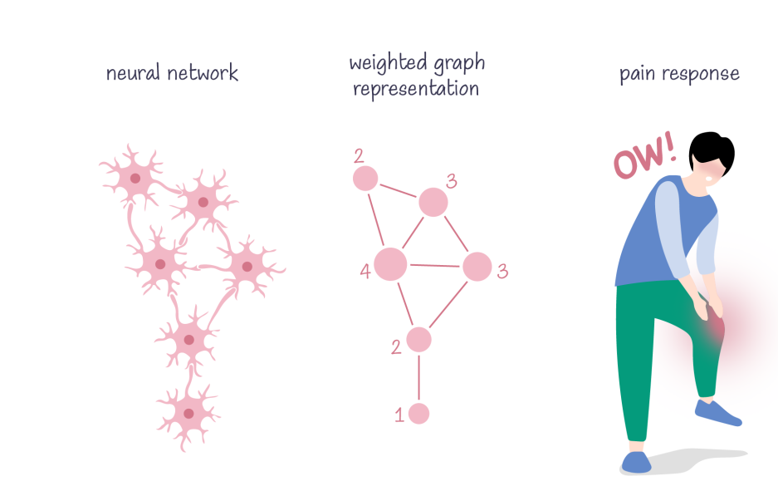
Types of Networks: Biological

Slide 5
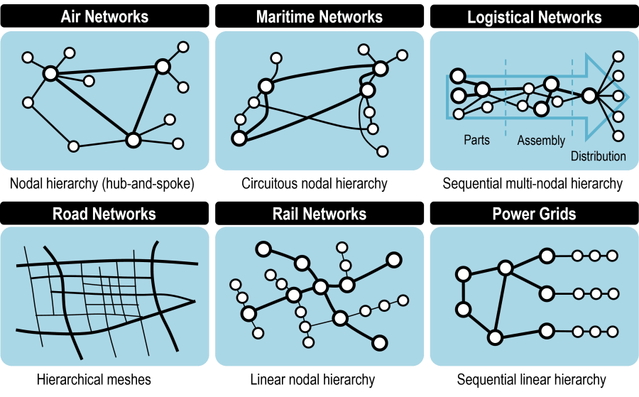
Types of Networks: Transportation

Slide 6
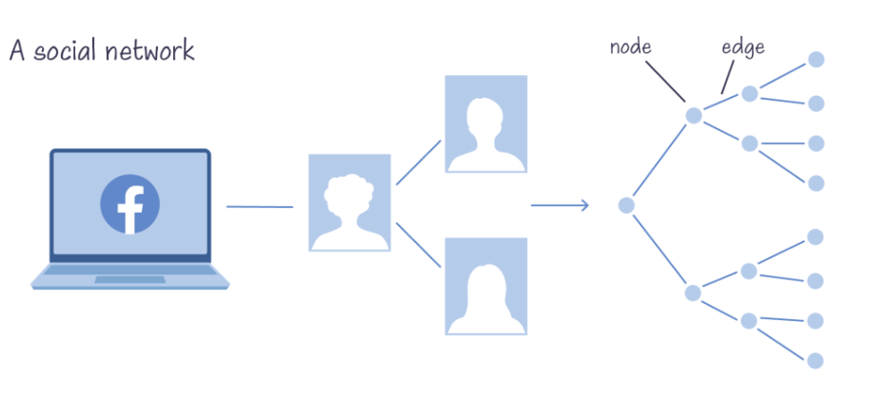
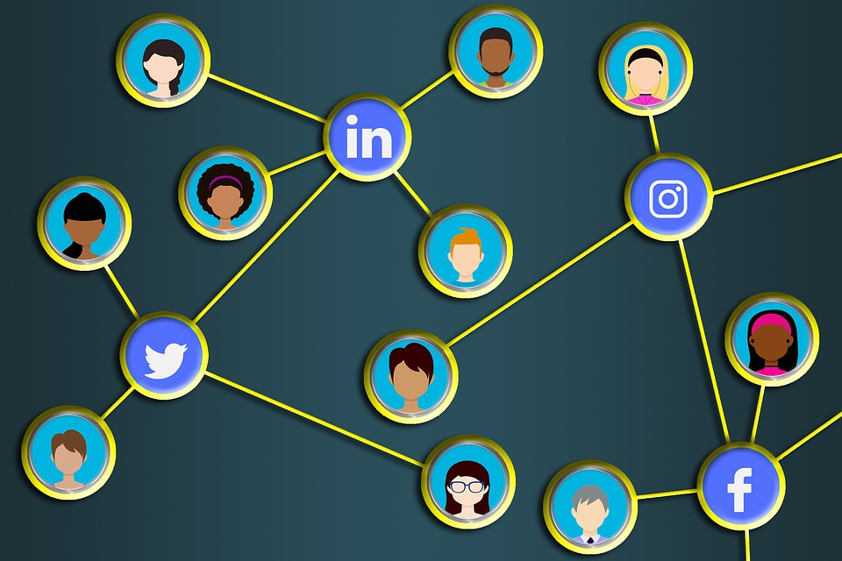
Types of Networks: Social

Slide 7
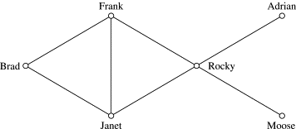
Networks as Graphs
A network is a real life or contextualized application of a graph.
Graph Network
Nodes/Vertices
Edges

Slide 8
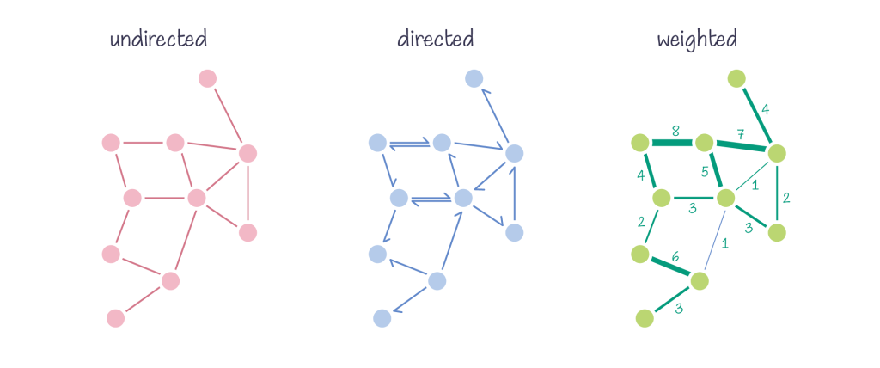
Types of Graphs

Slide 9
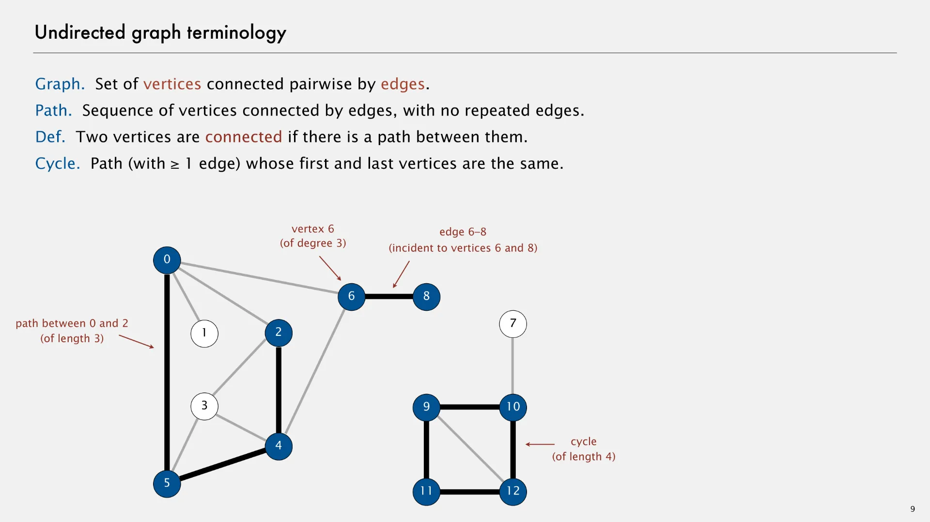
Undirected Graphs

Slide 10
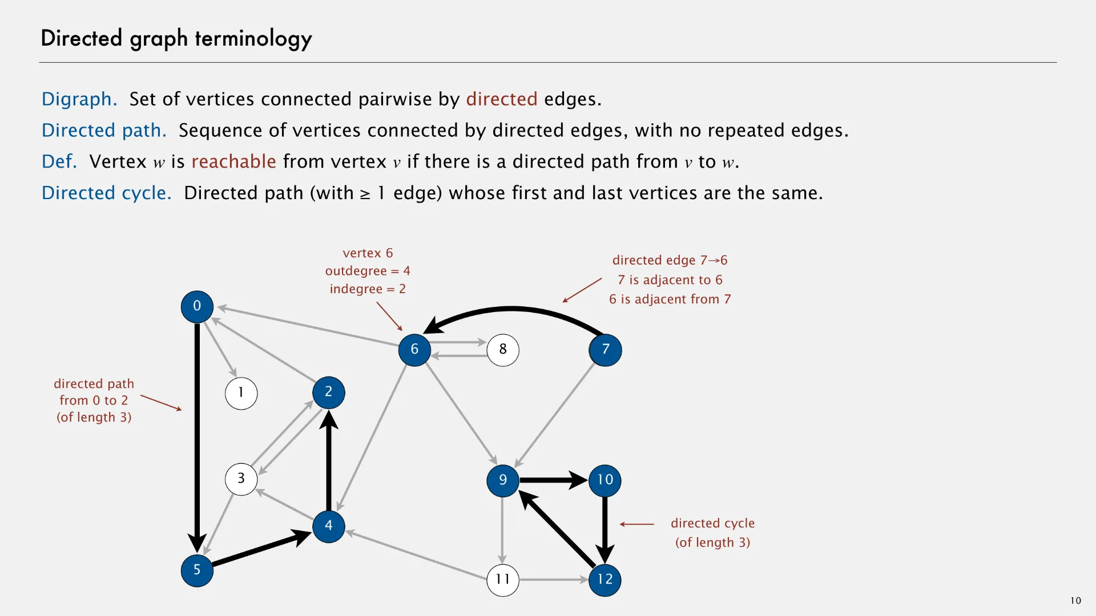
Directed Graphs

Slide 11
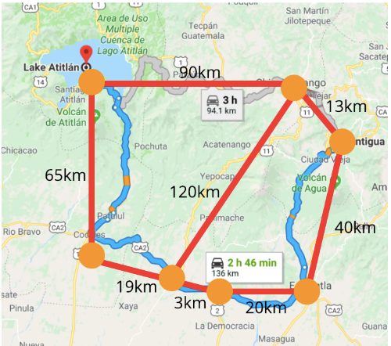
Weighted Graphs
A weighted graph is a graph where each edge has a value (called a weight) that represents the strength, cost, distance, or any measurable quantity of the connection between two nodes.
Common Types of Weights:
Distance: Physical or abstract distance. Example: Road networks.
Cost: Resources needed to traverse the edge. Example: Airline ticket prices.
Strength: Intensity or frequency of interaction. Example: Number of messages between people.
Probability: Likelihood of an event along the edge. Example: Probabilistic connections in decision trees.

Slide 12
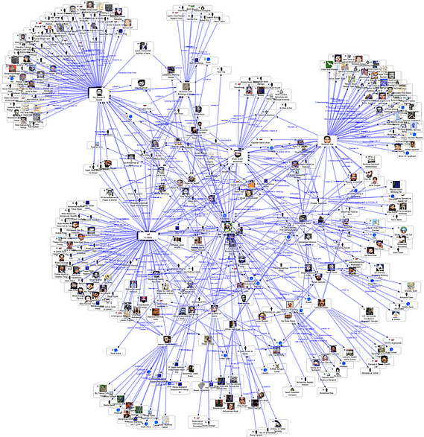
Social Networks: Key Terms
Density: The proportion of actual connections to all possible connections in the network. Indicates how interconnected the network is.
Bridge Node: A node that connects two otherwise separate parts of a network.
Centrality: Measures the importance or influence of a node:
Degree Centrality: Based on the number of direct connections.
Eigenvector Centrality: Based on quantity and quality of direct connections
Betweenness Centrality: Based on how often a node acts as a bridge.
Closeness Centrality: Based on a node's proximity to all others.
Cycles: Closed paths in the network where a node can be revisited starting from itself (e.g., A → B → C → A). Important for detecting feedback loops or recurring patterns.
Path Length: The number of edges in the shortest path between two nodes.

Slide 13
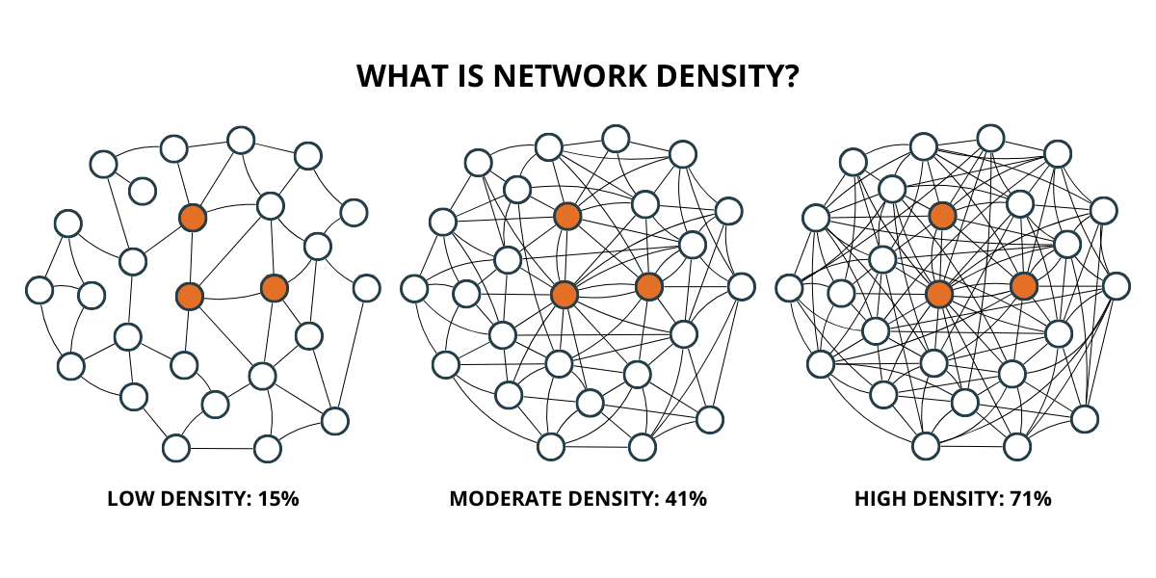
Density

Slide 14
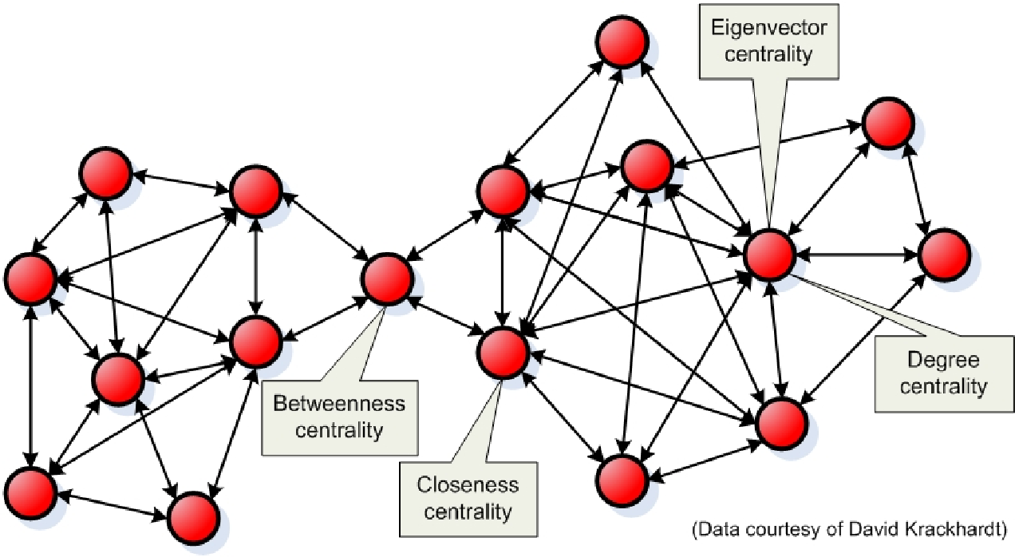
Centrality

Slide 15
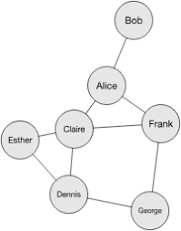
Cycles
Have you ever been shown a meme you saw the day before, been told the same joke twice, or heard the same news from multiple sources? That’s due to cycles in your social network. A cycle in a network is a closed loop where a path connects a series of nodes and eventually returns to the starting node.
For example, Bob tells Alice a piece of information. Alice shares it with Claire and Frank. Claire passes it to Esther and Dennis, while Frank shares it with Claire and George. Then George relays it back to Dennis. Both Claire and Dennis hear the same message twice, from two different sources, increasing the reliability of the information, but decreasing the efficiency due to all of the unnecessary repetition.

Slide 16
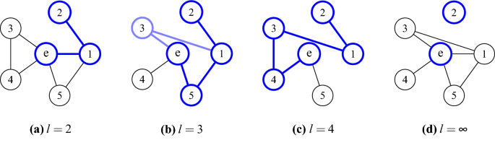
Path Length

Slide 17
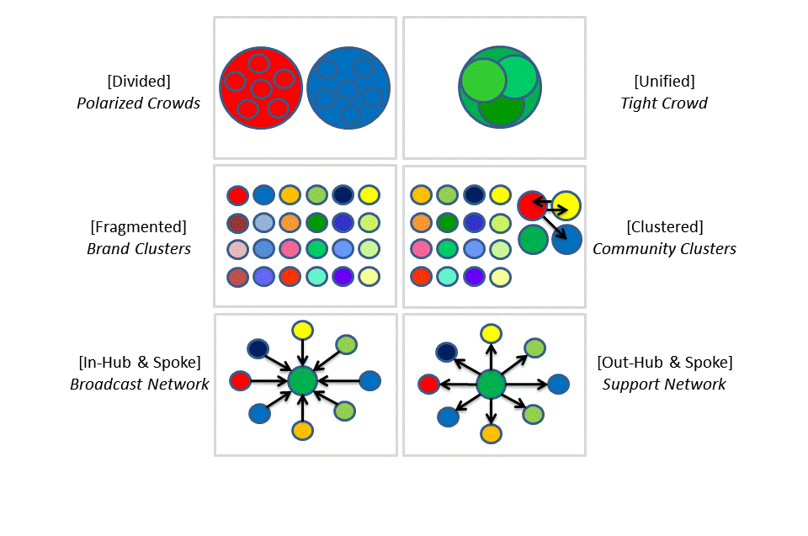
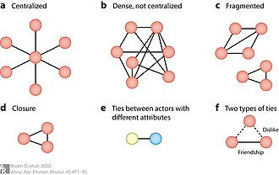
Common Social Network Patterns:

Slide 18
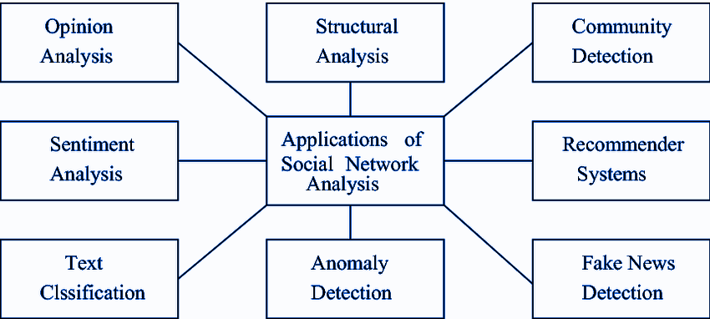
Applications of Social Networks:

